Slide 1
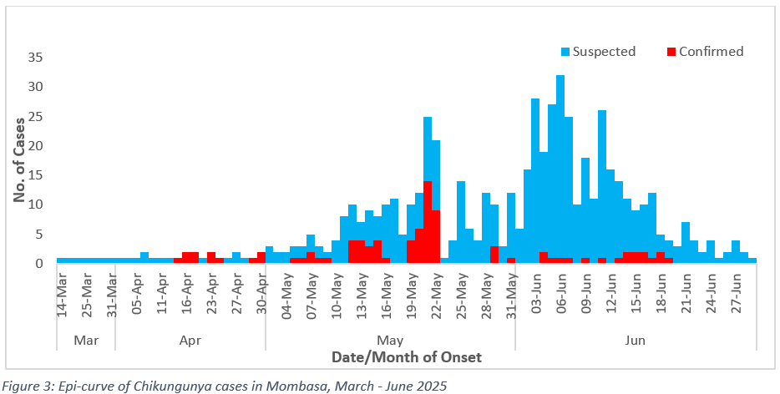
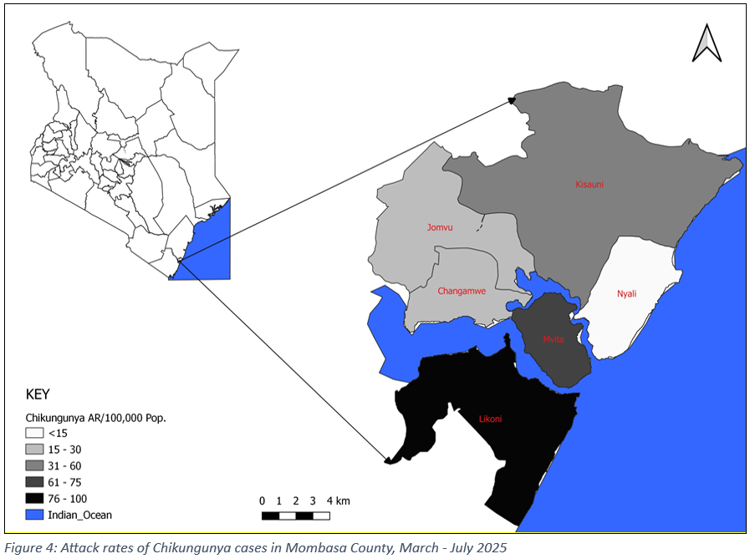
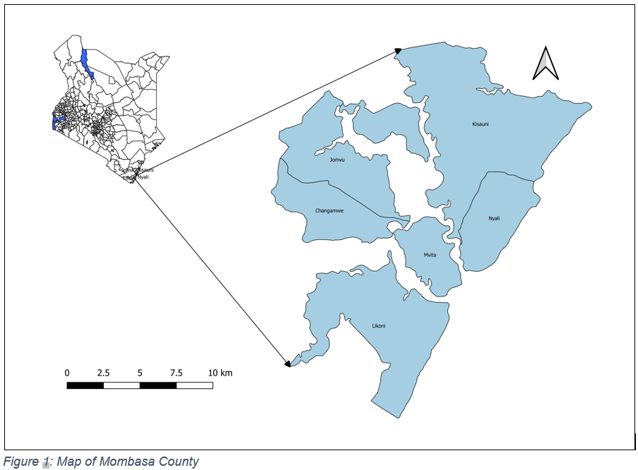
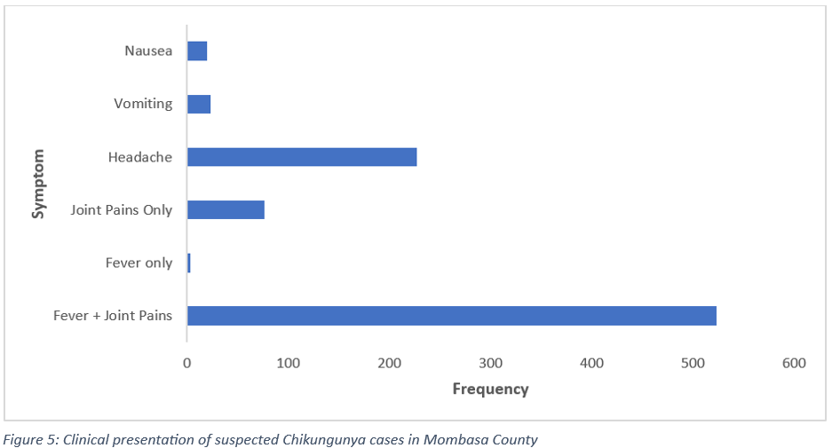
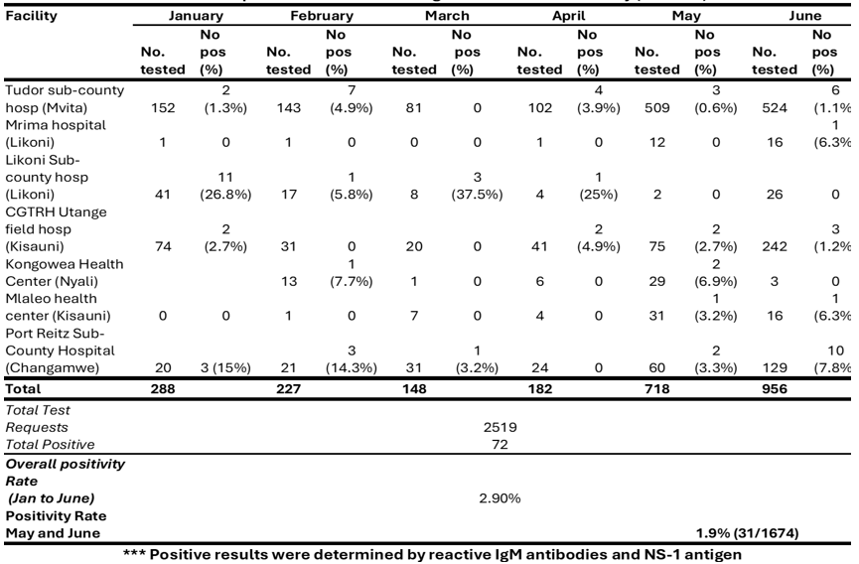
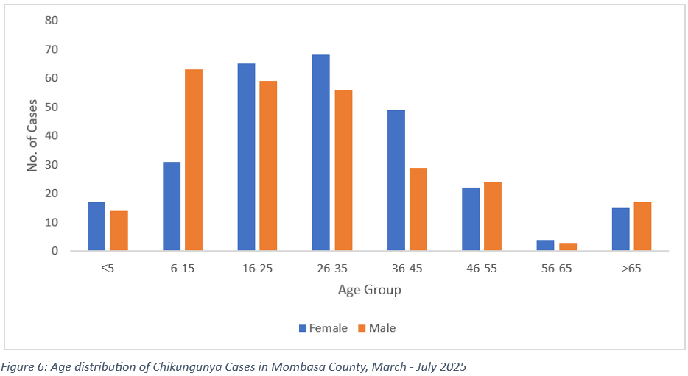
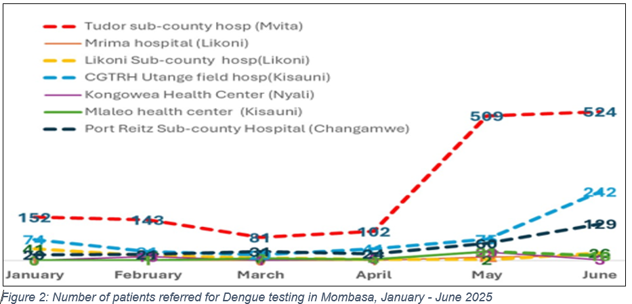
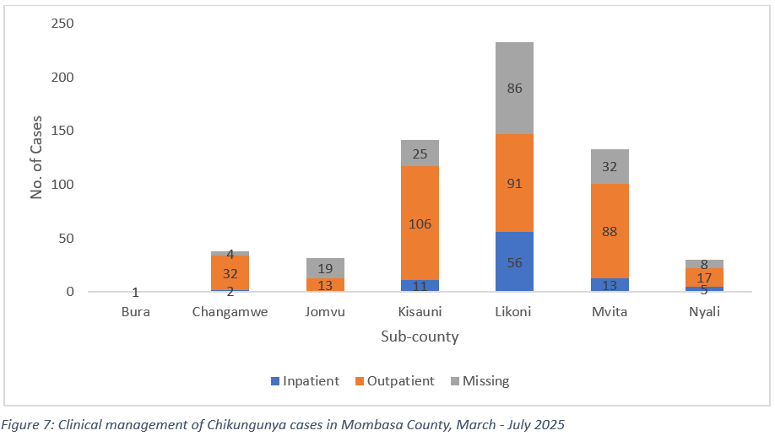
Outbreak Investigation: Chikungunya in Mombasa County, March – July 2025
Francis Muoka^{1,&}, Sophie Mokami¹, Sophie Moraa¹, Wellington Oduol¹, Eddy Odari³, Mary Mathenge², Fredrick Ouma¹, Samuel Kadivane¹, Kanana Kimonye¹
¹Kenya National Public Health Institute (KNPHI), Nairobi, Kenya, ²AMREF Health Africa, Nairobi, Kenya, ³Jomo Kenyatta University of Agriculture and Technology, Kiambu, Kenya
BACKGROUND
DISCUSSION
Chikungunya is a vector-borne viral infection caused by the Chikungunya virus (CHIKV)
Presents with non-specific symptoms such as fever and joint pain
Mombasa County is vulnerable due to its tropical climate and seasonal rains
The index case of Chikungunya was detected on 14th March 2025, while the latest case was reported on 29th June 2025
In total, 612 cases were line-listed using the working case definition, with 101 of these confirmed by PCR, no deaths reported
Highest number of cases reported in June 2025 (329/612)
Outbreak of Chikungunya declared in May 2025, two months after index case
Late detection of outbreak possibly due to inadequate capacity of healthcare workers to detect cases (lack of clear case definition)
Chikungunya cases reported in all six (6) subcounties:
Highest number of cases (233/612) in Likoni Subcounty
Lowest number of cases (30/612) in Nyali Subcounty
Highest attack rate (80.86/100,000) in Likoni Subcounty
Most cases (248/612) aged 16-35 years, with females (271/536) more than males
Most common clinical presentation was fever and joint pain (523/612)
Majority of the cases (347/612) managed as outpatients
Possible risk factors for the outbreak include the tropical climate, seasonal rain and poor WaSH infrastructure – availability of breeding sites for mosquitoes
Lack of public awareness on Chikungunya observed during the investigation
Only Tudor Subcounty Hospital was conducting CHIKV testing
Adult mosquitoes and larvae were collected and sent to KEMRI for analysis
OBJECTIVE
To determine the magnitude and control the spread of Chikungunya Virus Disease in Mombasa County
METHODOLOGY
Table 2: Distribution of Chikungunya per subcounty in Mombasa County, March – July 2025
We employed a mixed-methods approach, including a review of hospital records, vector surveillance, and sensitization of healthcare workers
Suspected case: any with an acute onset of fever >38.5°C and severe joint pain not explained by other medical conditions
We conducted vector surveys in areas with documented cases using a systematic random sampling
We conducted descriptive analysis of Chikungunya cases from March to July 2025
Sub-county | Cases | Population | AR/100,000
Nyali | 30 | 254,793 | 11.77
Jomvu | 32 | 188,076 | 17.01
Changamwe | 38 | 151,785 | 25.04
Kisauni | 142 | 344,768 | 41.19
Mvita | 133 | 177,437 | 74.96
Likoni | 233 | 288,140 | 80.86
Others | 4 | - | -
TOTAL | 612 | 1,404,999 | 43.35
STUDY AREA
Mombasa County, Kenya
CONCLUSION
Chikungunya is an emerging disease in Kenya, epidemiological patterns poorly understood
Clinical presentation of Chikungunya mimics malaria and dengue fever (both endemic in Mombasa) – difficult to detect
Inadequate capacity (healthcare workers and laboratory) possibly led to late detection of the cases
Time of outbreak suggestive of association with rainy season when vector density is high
Almost equal distribution between genders suggests equal exposure to the virus
RESULTS
Table 1: Number of patients referred for Dengue testing in the laboratory, January – June 2025
RECOMMENDATIONS
Enhance surveillance for Chikungunya through inclusion in routine IDSR reporting and distribution of a clear case definition
Capacity building frontline health workers for early detection
Support Mombasa County to develop laboratory capacity for confirmatory testing of Chikungunya
Enhance risk communication and community engagement by sensitizing Community Health Promoters
Develop a national and county-level Chikungunya Preparedness and Response Plan to guide preparedness and response
In-depth research on transmission patterns, including vector analysis and evaluation of risk factors for the disease
LIMITATION
Long turnaround time of vector analysis results from KEMRI
Contact: nyaikafrank@gmail.com

